Slide 1
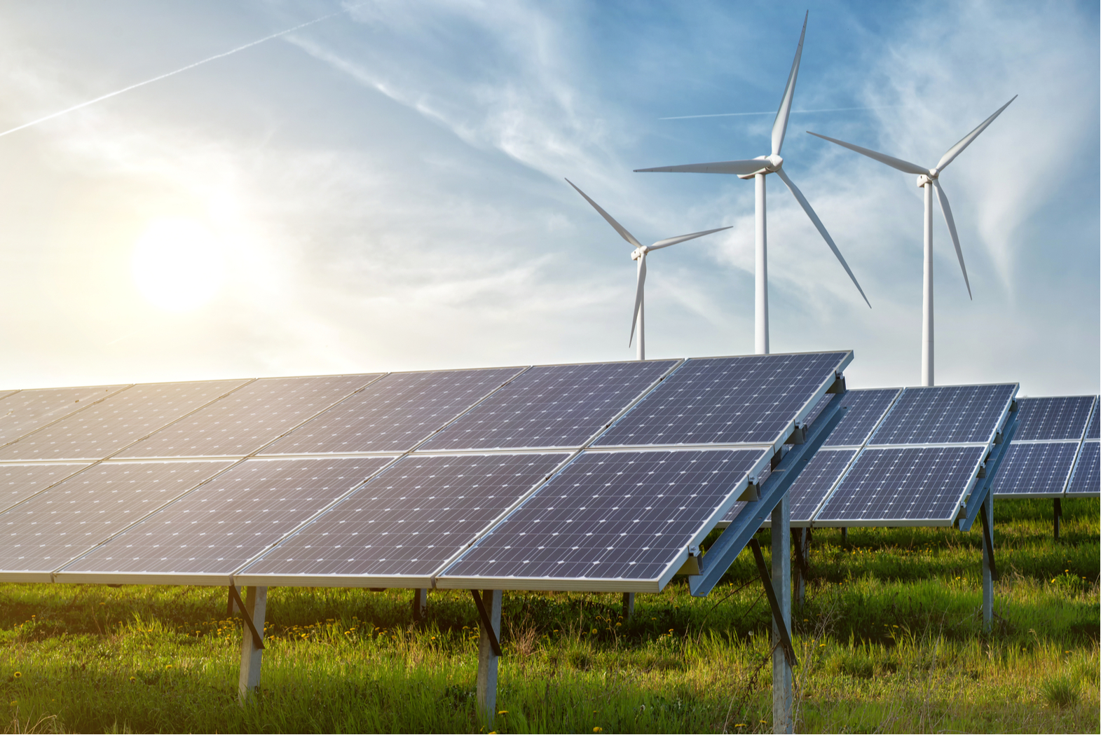


Data Science:
Finding Ideal Locations for Green Energy
Lena Kögel, Sönke Maibach, Gabriel Sacher, Simon Schad, Laura Marie Schiffers
25.09.2021 | Mentor: Amine Jebari | TechLabs Düsseldorf

Slide 2
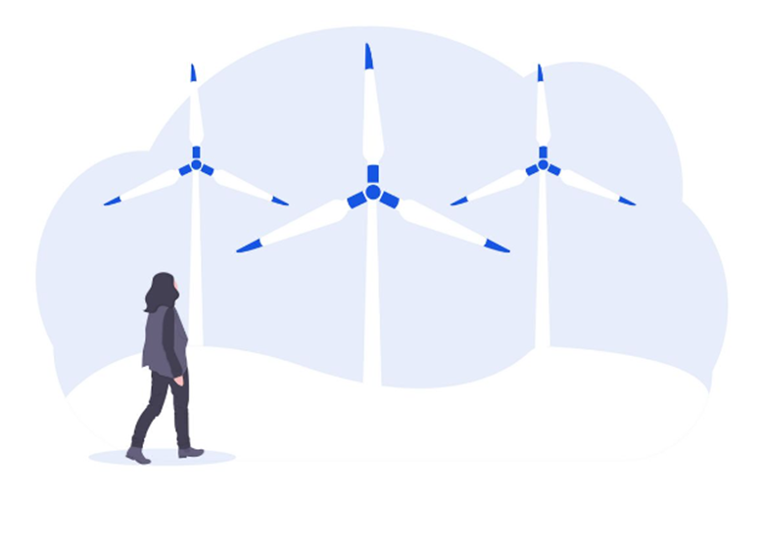

Data Science:
Finding Ideal Locations for Green Energy
Lena Kögel, Sönke Maibach, Gabriel Sacher, Simon Schad, Laura Marie Schiffers
25.09.2021 | Mentor: Amine Jebari | TechLabs Düsseldorf

Slide 3

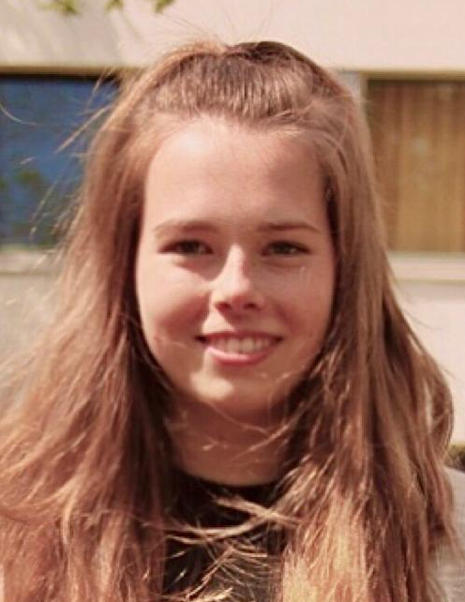

The Team Groovy Green Geeks
Sönke
Math & Statistics Teacher
Lena
Master Chemical Engineering
Simon
Text
Laura Marie
Text
Gabriel
Text
Amine
Mentor

Slide 4
Introduction Project Idea
Analyse wind and solar data
Look at legal requirements as well as meterological data (wind speeds, sunlight hours, etc.) and consisting infrastructure (high voltage lines)
Show these locations a map (Highlight the best locations with a colour-ranking)
Optional: Calculate the amout energy that can be produced at a specific location
Optional: Calculate the break even-point
→ Goal: Recommend ideal locations for solar or wind parks

Slide 5
Working Steps Overview
Step 1
Step 2
Step 3
Step 4
Step 5
1.
2.
3.
4.
5.
TextTextText
TextTextText
TextTextText
TextTextText
TextTextText
TextTextText
TextTextText
TextTextText
TextTextText
TextTextText
TextTextText
TextTextText
TextTextText
TextTextText
TextTextText

Slide 6
First Headline Second Headline

Slide 7
First Headline Second Headline

Slide 8
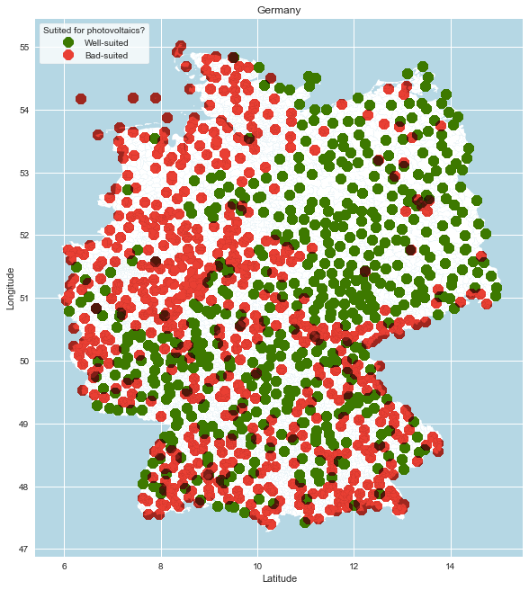
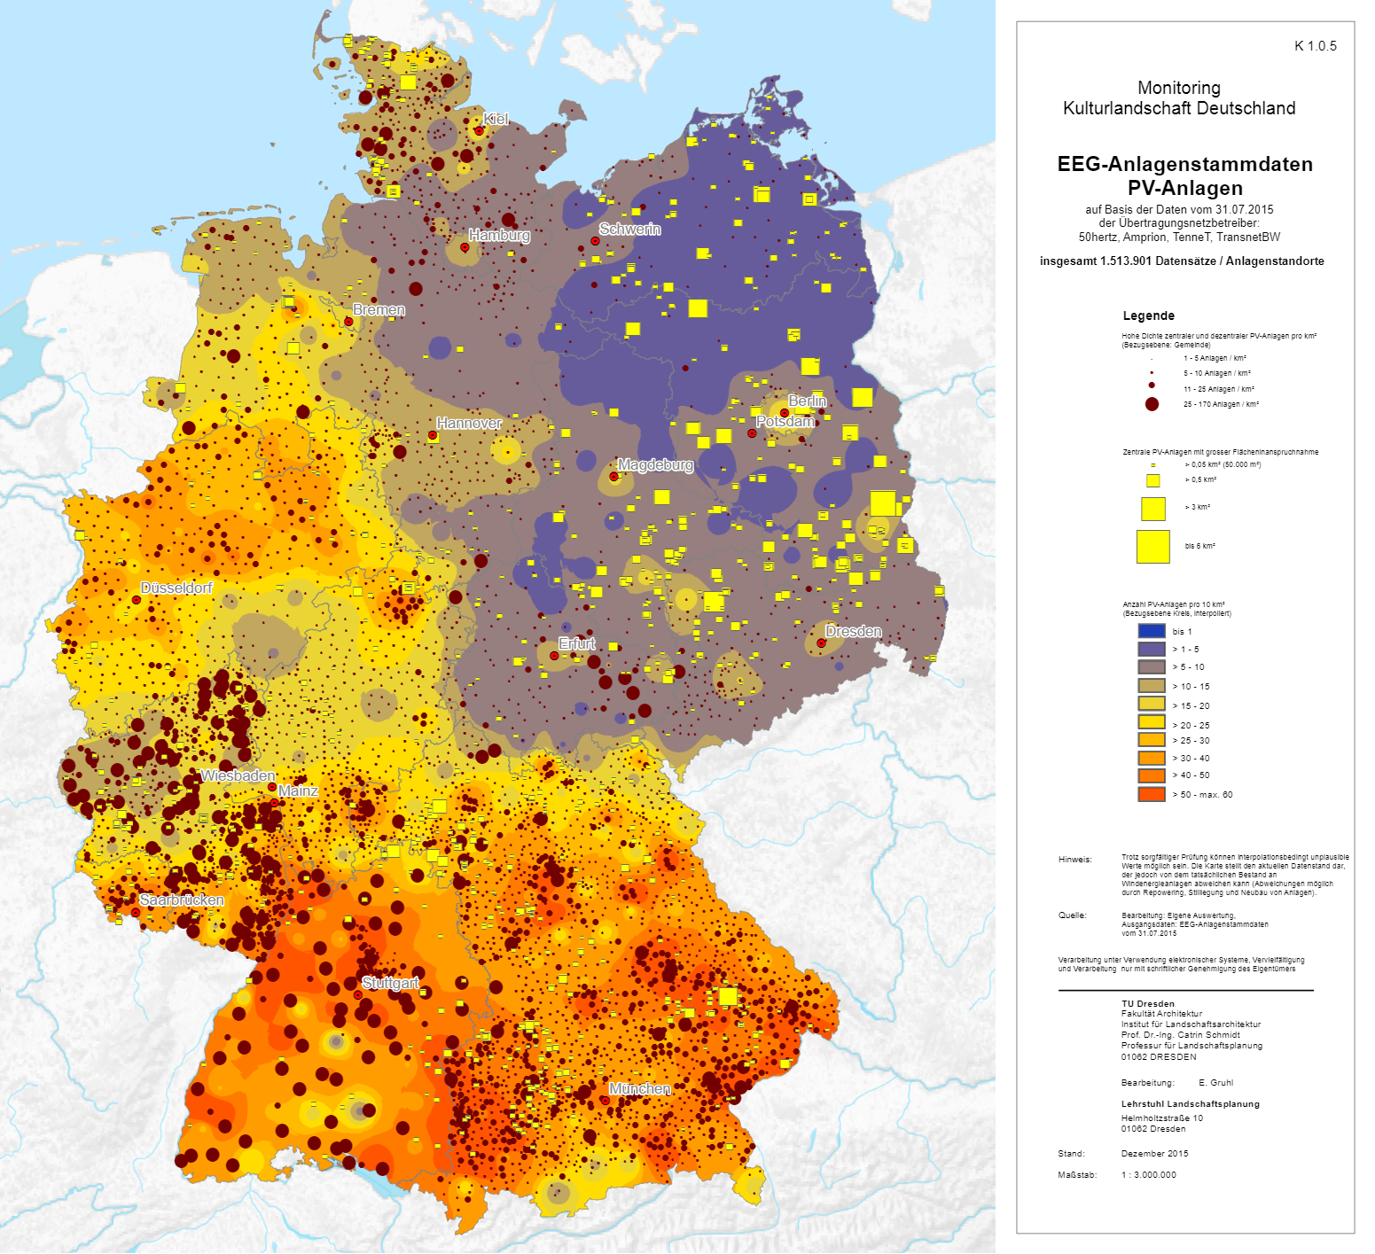
Results Solar Energy Locations
Our prediction
Solar energy locations Germany 2015

Slide 9
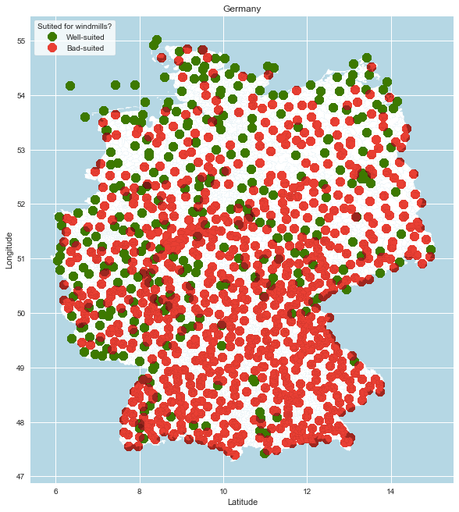
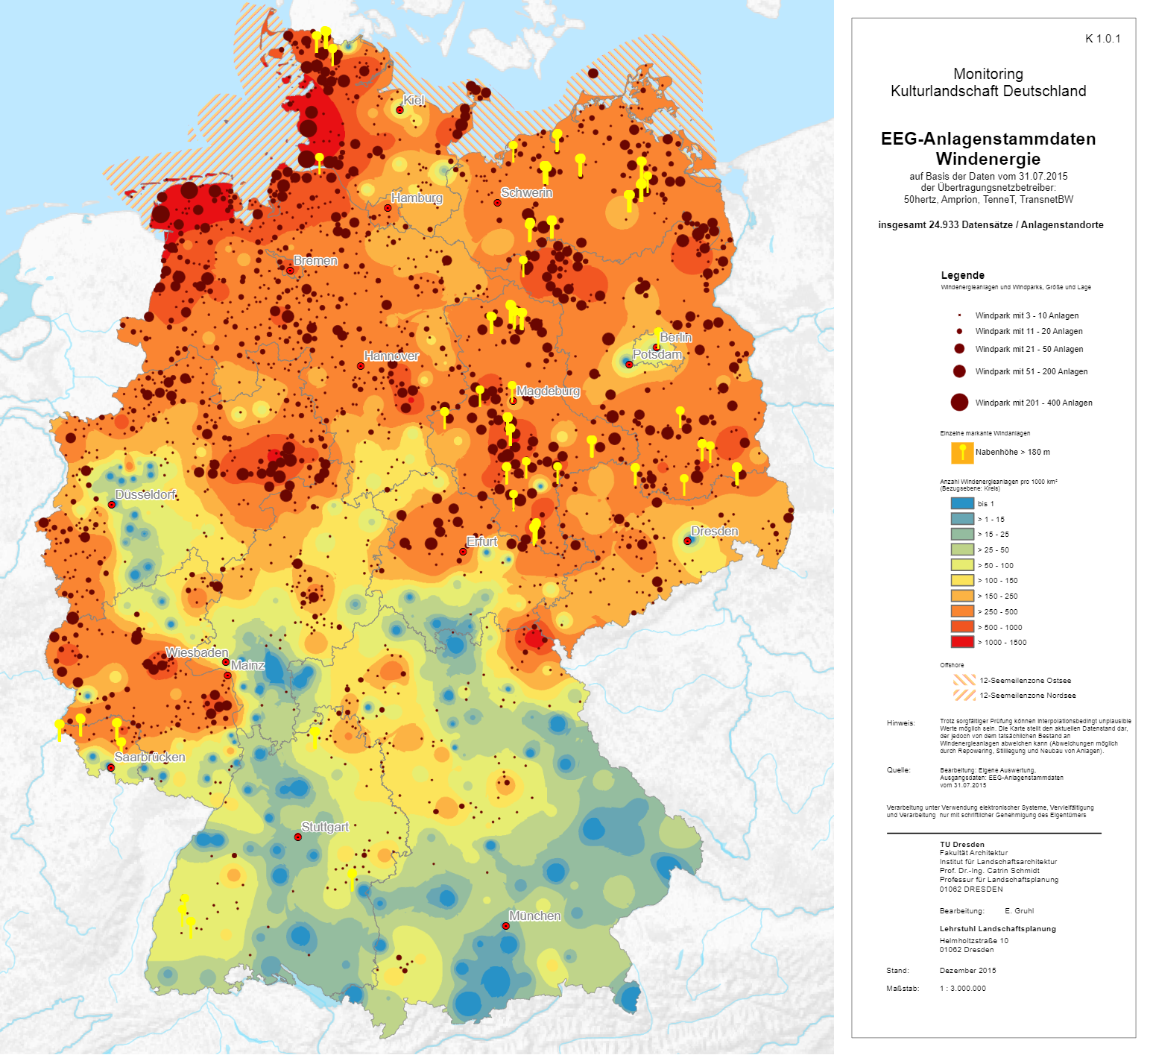
Results Wind Energy Locations
Our prediction
Wind energy locations Germany 2015

Slide 10




First Headline Second Headline

